Slide 1
Tutorial 7
Advanced Ionic
Performance Testing
CS551 Advanced Software Engineering
UMKC

Slide 2
Topics to cover
Plugins
Performance Testing

Slide 3
Plugins
Camera

Slide 4
Inclusion of Plugins
ionic start ImageApp blank
cd ImageApp
ionic platform add android
cordova plugin add cordova-plugin-camera
Download Firebase Angularfire, Firebase Javascript api and Cordova from below url’s.
script src="https://www.gstatic.com/firebasejs/3.3.0/firebase.js
https://cdn.firebase.com/libs/angularfire/2.0.2/angularfire.min.js
http://ngcordova.com/
ionic build android
ionic run android
Notes:
http://ngcordova.com/docs/plugins/facebook/

Slide 5
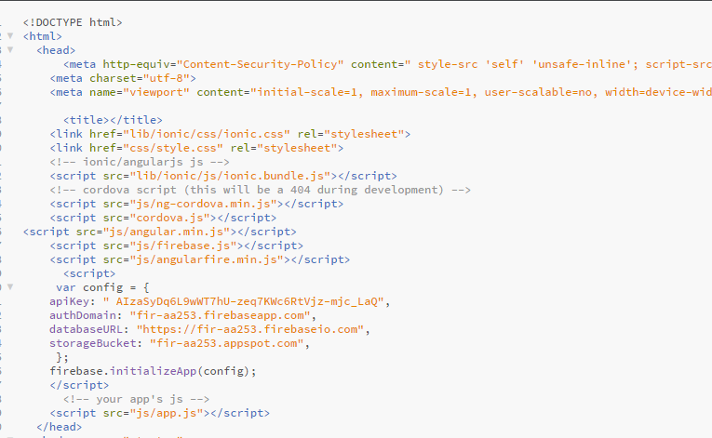
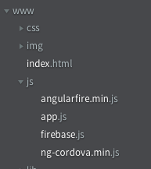
ImageApp
Copy and import angular.min.js, firebase.js and ng-cordova.min.js(downloads/ng-cordova-master/dist/) to your project.

Slide 6
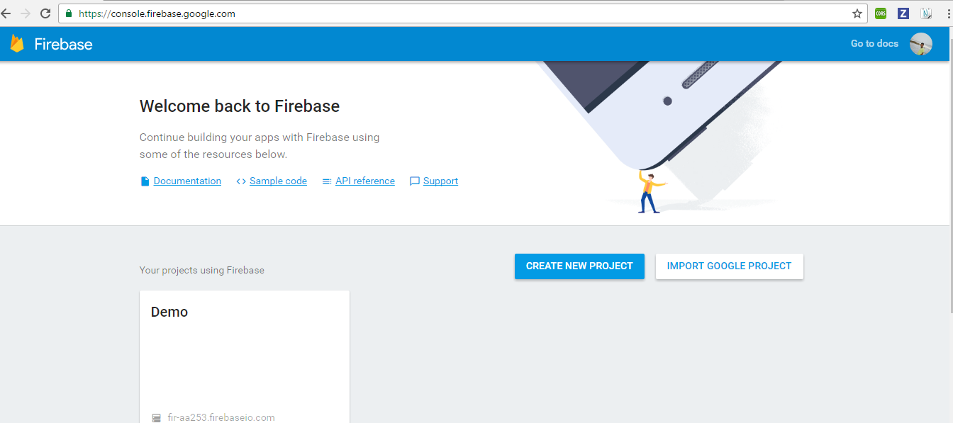
Firebase:
https://console.firebase.google.com/
Creating App :

Slide 7
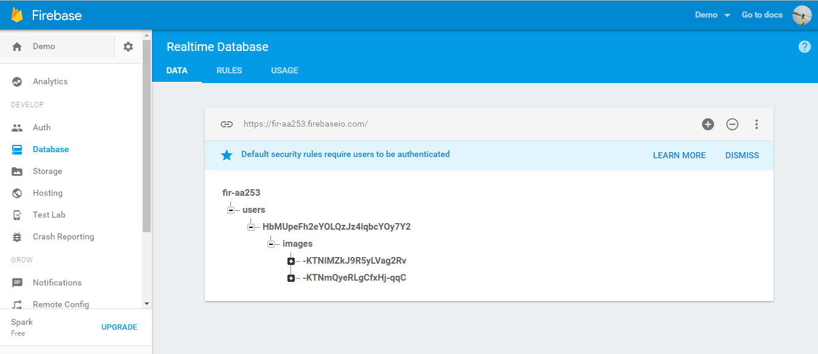
Firebase dashboard:
Dashboard contains your app information.

Slide 8
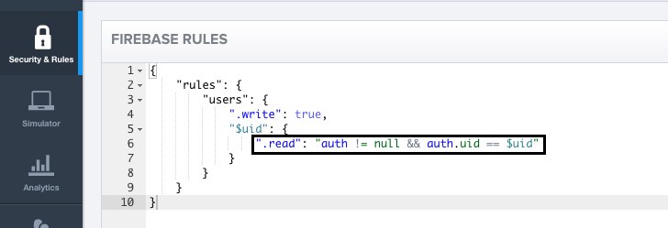
Firebase Rules:
Creating rules for your firebase:
Restricting other users to access your data.

Slide 9
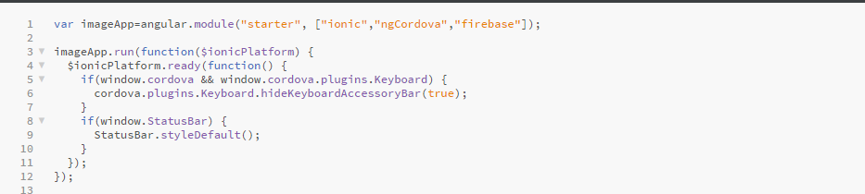
ImageApp - app.js
dependencies

Slide 10
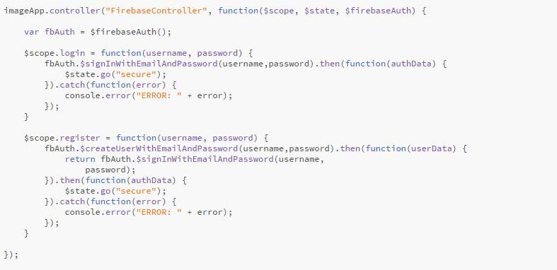
app.js
Firebase validation and registration:

Slide 11
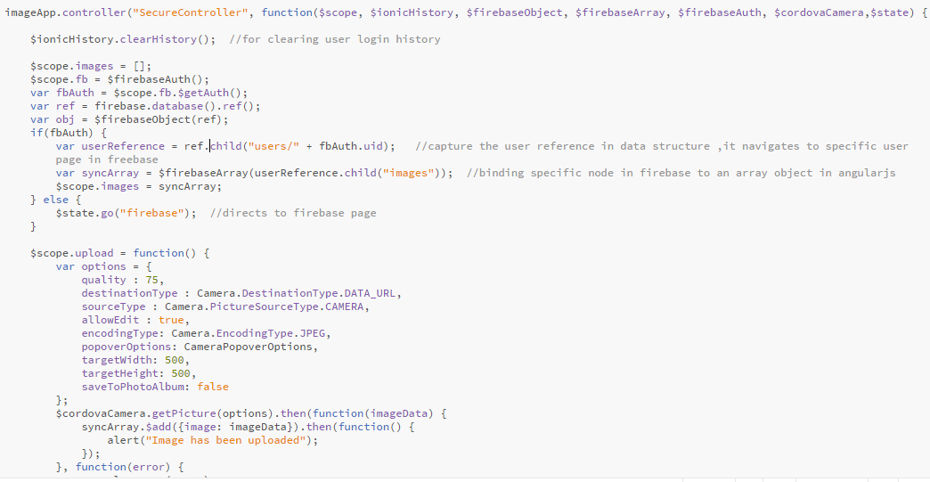
app.js
Taking picture and uploading in Firebase

Slide 12
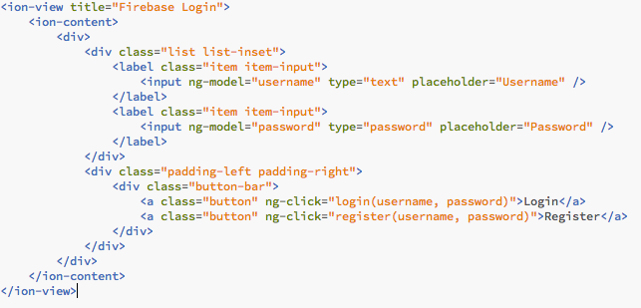
templates
Create ‘firebase.html’ in templates folder.

Slide 13
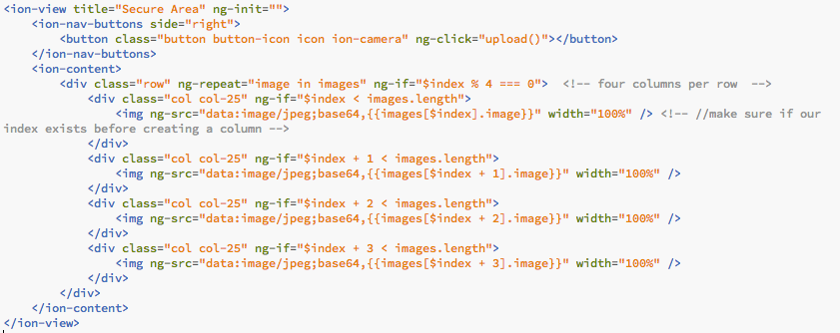
ImageApp - Secure.html
Create secure.html in templates folder

Slide 14
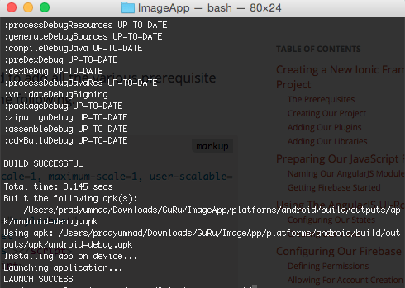
Execution:
ionic build android
ionic run android

Slide 15
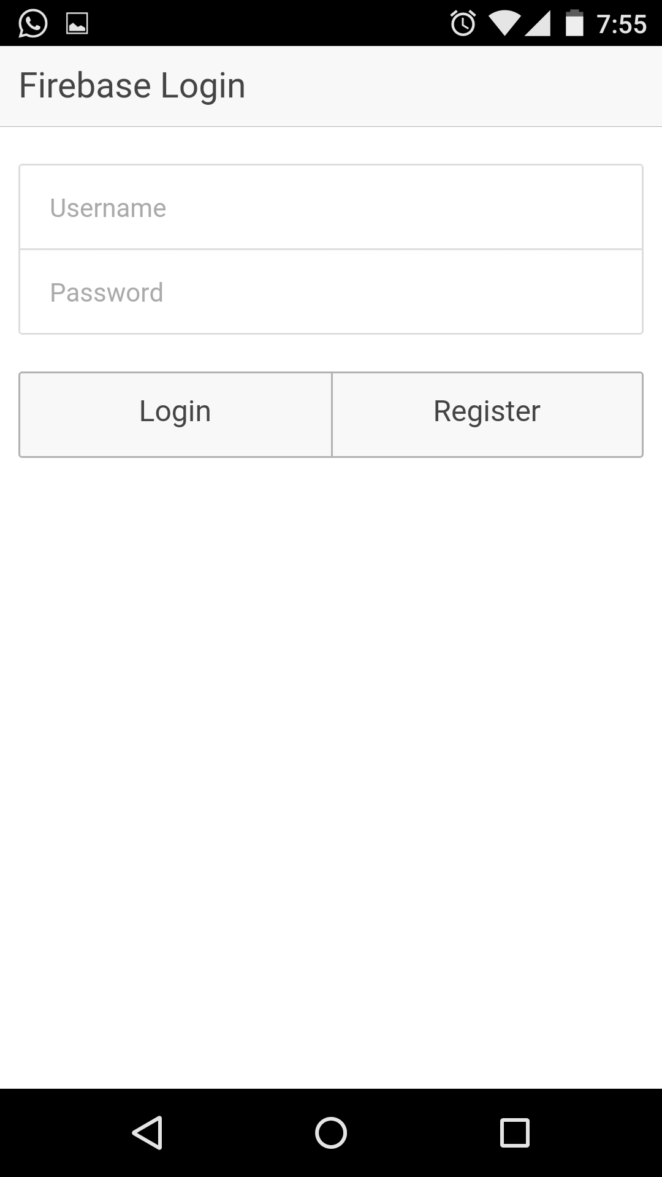
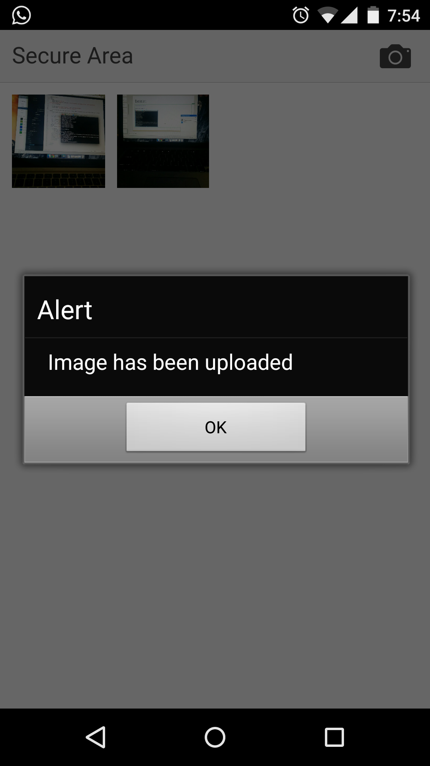

Slide 16
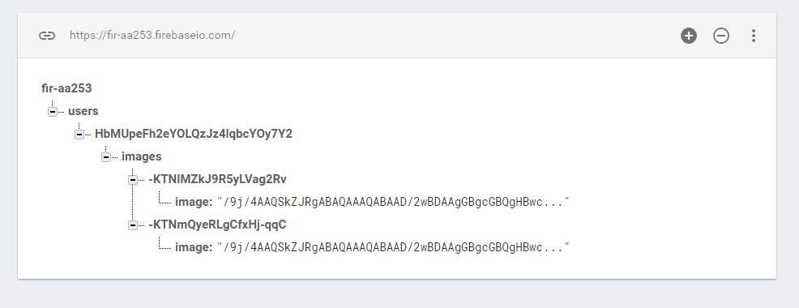
Firebase storage

Slide 17
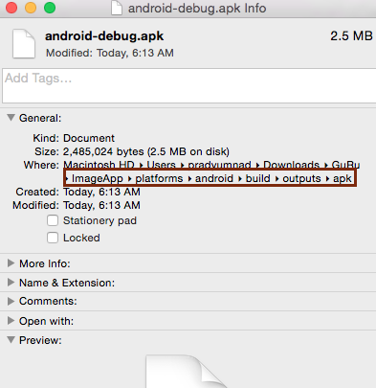
Deployment
Once you build your application
an apk file will be created in your
application build folder.
Appname\platforms\android\build\outputs\apk
Copy the apk file to your android device
and install the application for deployment.

Slide 18
More.. Plugins
http://ngcordova.com/docs/plugins/

Slide 19
Performance Testing
YSlow
Firebug

Slide 20
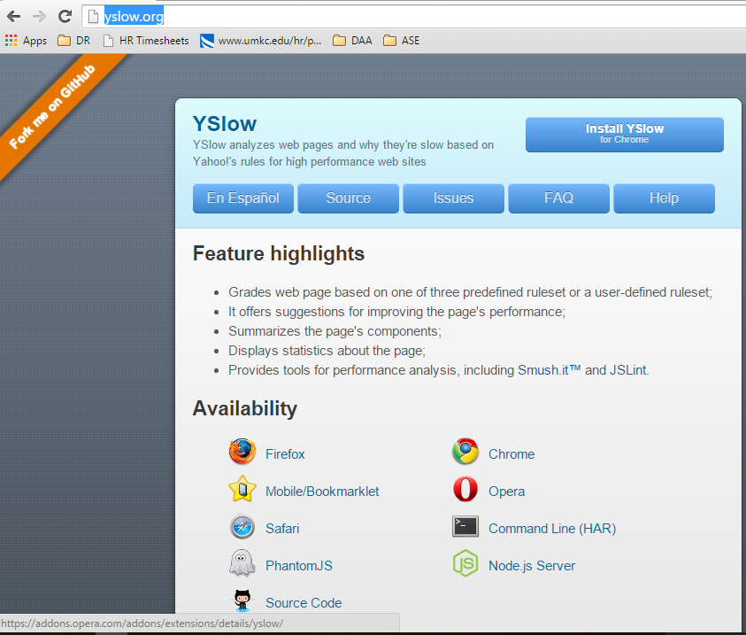
YSlow
http://yslow.org/

Slide 21
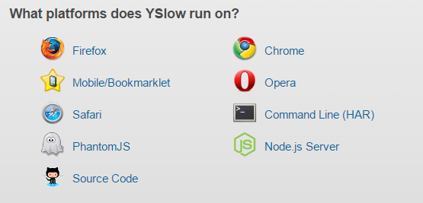
YSlow Analyzer
YSlow is a tool that analyzes web pages and suggests ways to improve
performance and user experience based on a set of rules.
1)Run your application and
click on Yslow extension.
2)Yslow pane will open. Click
on “Run Test”

Slide 22
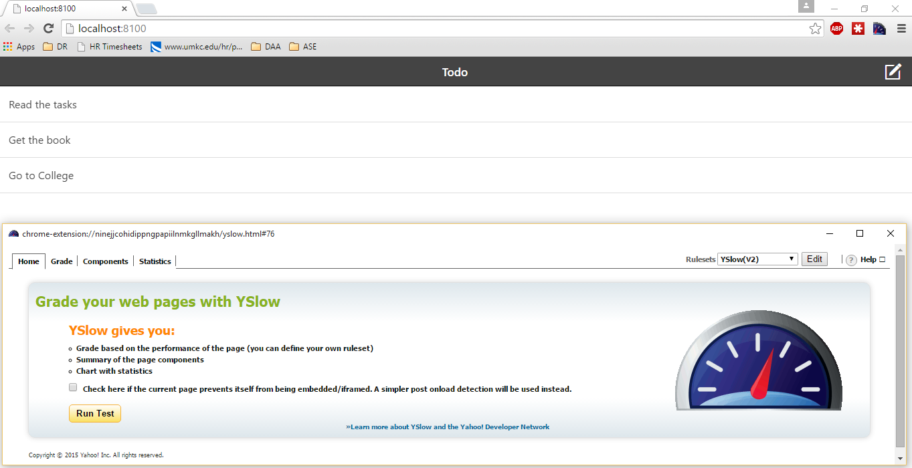
YSlow
Yslow extension

Slide 23
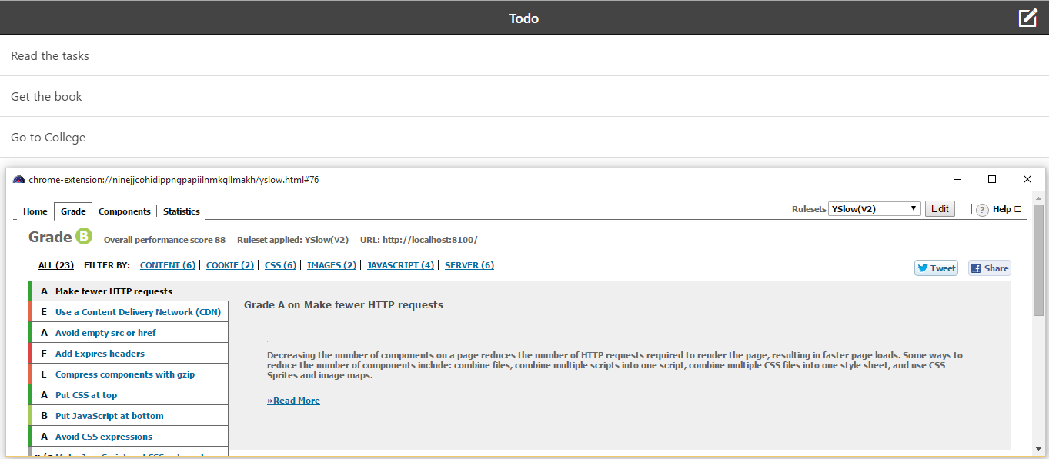
Yslow - Run test
Grade
Suggestions

Slide 24
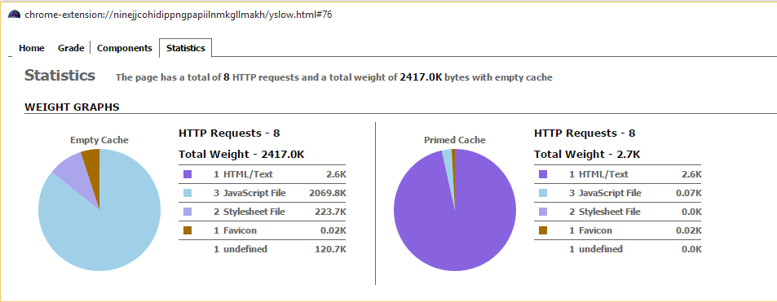
YSlow - Performance Statistics

Slide 25
Firebug
http://getfirebug.com/
Firebug integrates with Firefox to put a wealth of web development tools at your fingertips while you browse. You can edit, debug, and monitor CSS, HTML, and JavaScript live in any web page.
The firebug tool will automatically show us if there are any errors in the JavaScript, CSS or HTML code. It also displays any errors in request URL’s or XHR requests.

Slide 26
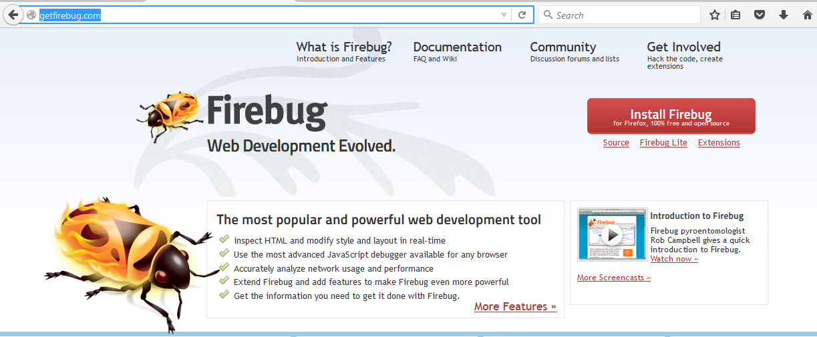
Firebug - Install for Firefox

Slide 27
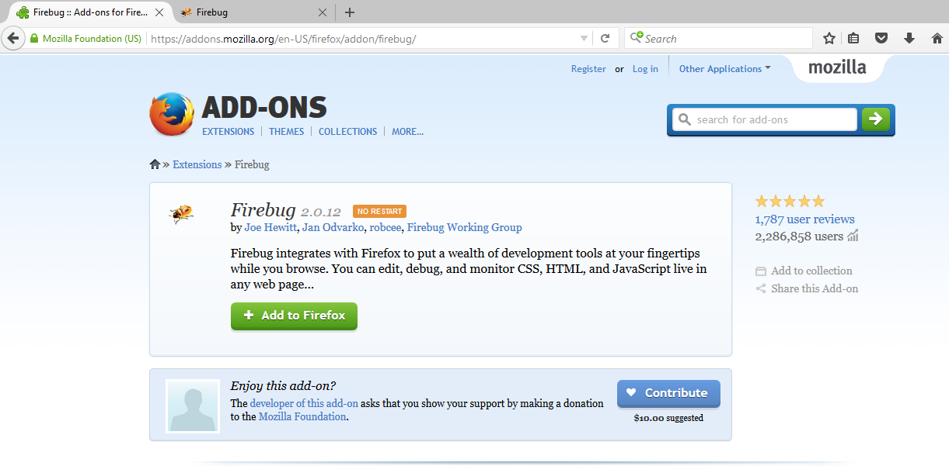
Firebug - Add Extension to Firefox

Slide 28
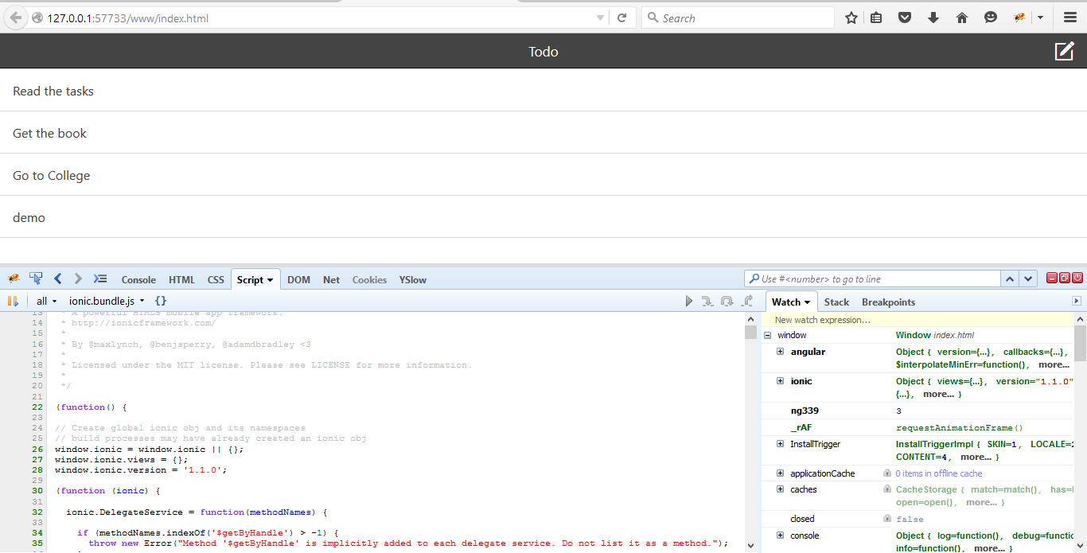
Firebug
Run your application in the browser and click on firebug extension.

Slide 29
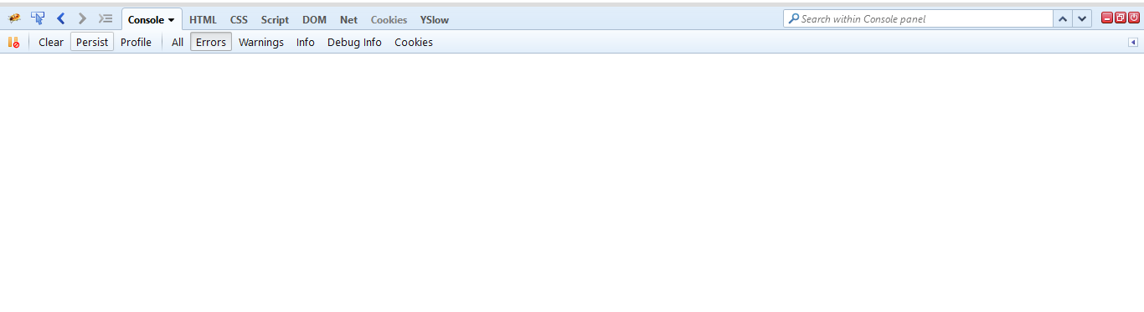
Firebug
Firebug displays any errors in the HTML, Javascript, CSS in the console pane.

Slide 30
Thank You

